Slide 1
Car Sharing

Slide 5
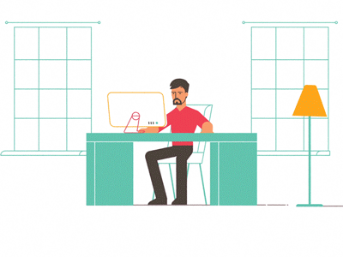

Slide 11
Free Parking

Slide 12
Free Parking
Trusted Renting
(Analyze Driving Style)

Slide 13
Free Parking
Trusted Renting
(Analyze Driving Style)
Make extra money

Slide 14
82m bizTravellers (EU)
Market Size

Slide 15
82m bizTravellers (EU)
27m travellers (Arlanda)
Market Size

Slide 16
82m bizTravellers (EU)
27m travellers (Arlanda)
18k parking spots
Market Size

Slide 18
25% Commission

Slide 19
25% Commission
300€

Slide 20
25% Commission
75€ Commission
300€

Slide 21
25% Commission
225€ Earning
75€ Commission
300€
+
Free Parking

Slide 22
25% Commission
225€ Earning
75€ Commission
300€
+
Free Parking
175€
750€

Slide 23
25% Commission
225€ Earning
75€ Commission
300€
+
Free Parking
175€
750€
SAVE 400€
SAVE 450€

Slide 24
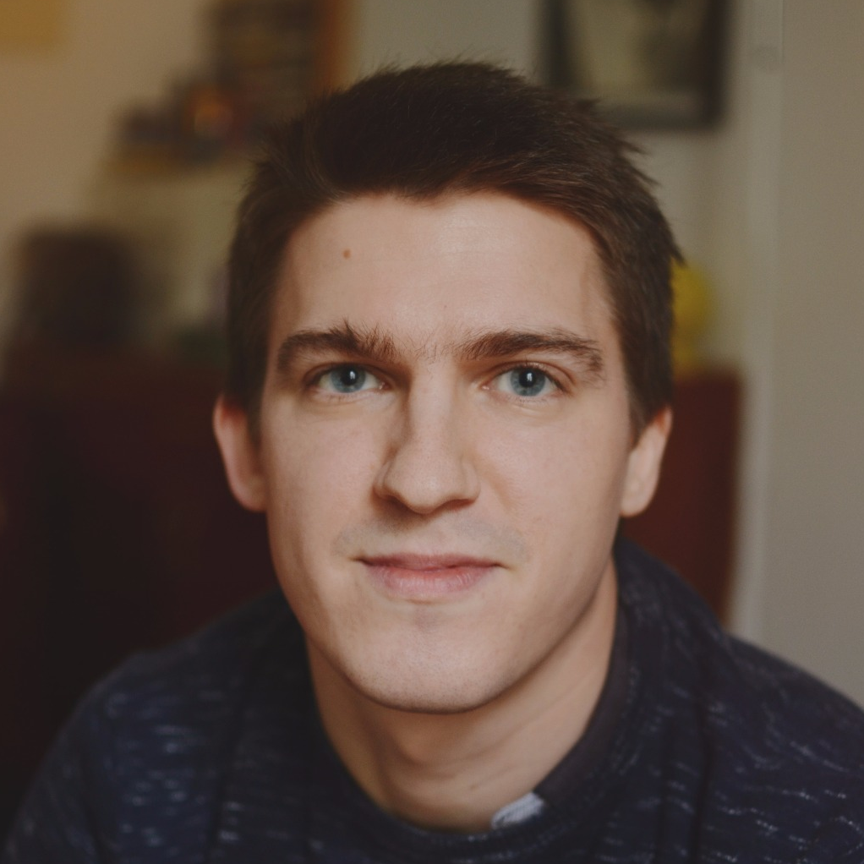
Massimo Perini
Charles Ferrari
Csaba Rohrer
Data Science
PhD Service Design
Data Science
Santhos
Imran Syed
Zaiqiao Ye
Software
Software/IT
Design/UX

Slide 25
Trust
Convenience

Slide 26
Europe
Schiphol
Swedavia Airports
2021
Stockholm Arlanda
2020
100M€ Revenue
2019
25M€ Revenue
2018
2000 Cars
100 Cars
25 Parking Spots
Business

Slide 27
Sharing is CARing
moveon.perini.me

